Slide 1


TELECOM CUSTOMER CHURN
PREDICTION
Data Science Program – August 2022
Domain Oriented Case Study
By -
Shekhar More
Kaveri Deotkar
Avik Kumar Saha

Slide 2
PROBLEM STATEMENT
In the telecom industry, customers are able to choose from multiple
service providers and actively switch from one operator to another. In this
highly competitive market, the telecommunications industry experienan average of 15-25% annual churn rate. Given the fact that it costs 5-10
times more to acquire a new customer than to retain an existingone, customer retention has now become even more important than
customer acquisition.

Slide 3
BUSINESS OBJECTIVES
In this project, our business objective is to analyse customer-level data
of a leading telecom firm, build predictive models to identify
customers at high risk of churn and identify the main indicators of
churn. Thus, our focus would be on
Retaining high profitable customers.
Predicting which customers are at high risk of churn (in order to devise customer retention strategies accordingly).

Slide 4
STEPS TO REACH OBJECTIVES
Importing and inspecting data
EDA
Dummy variables creation
Feature scaling
Dealing with class imbalance
Model Building & Evaluation
Conclusion & Recommendations

Slide 5
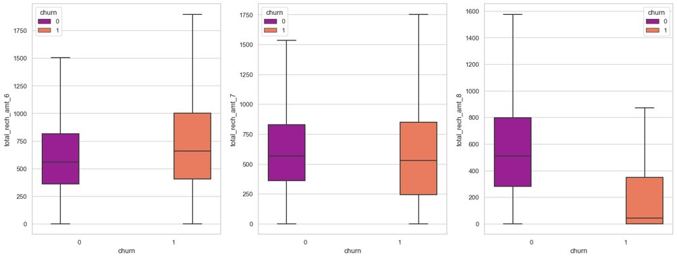
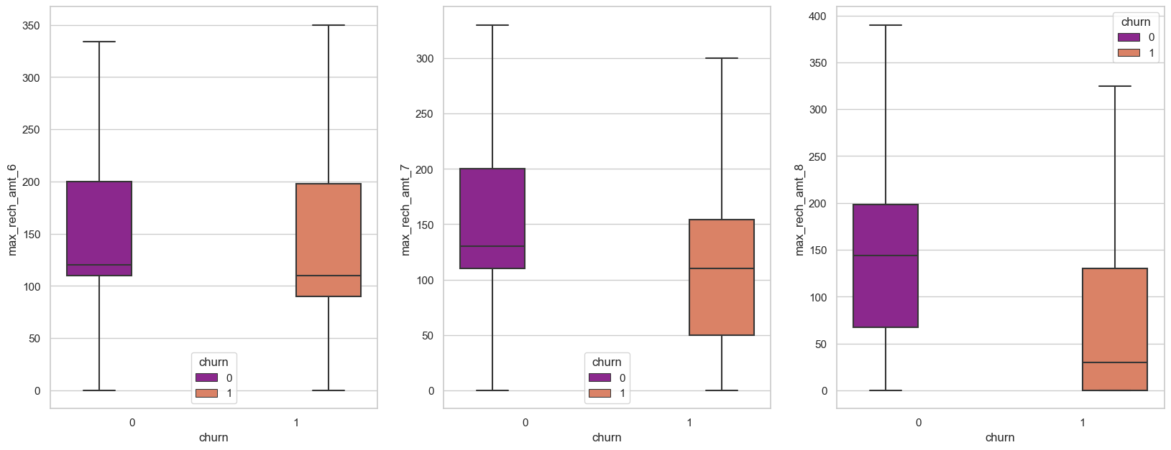
EDA (univariate analysis)
Outliers

Slide 6
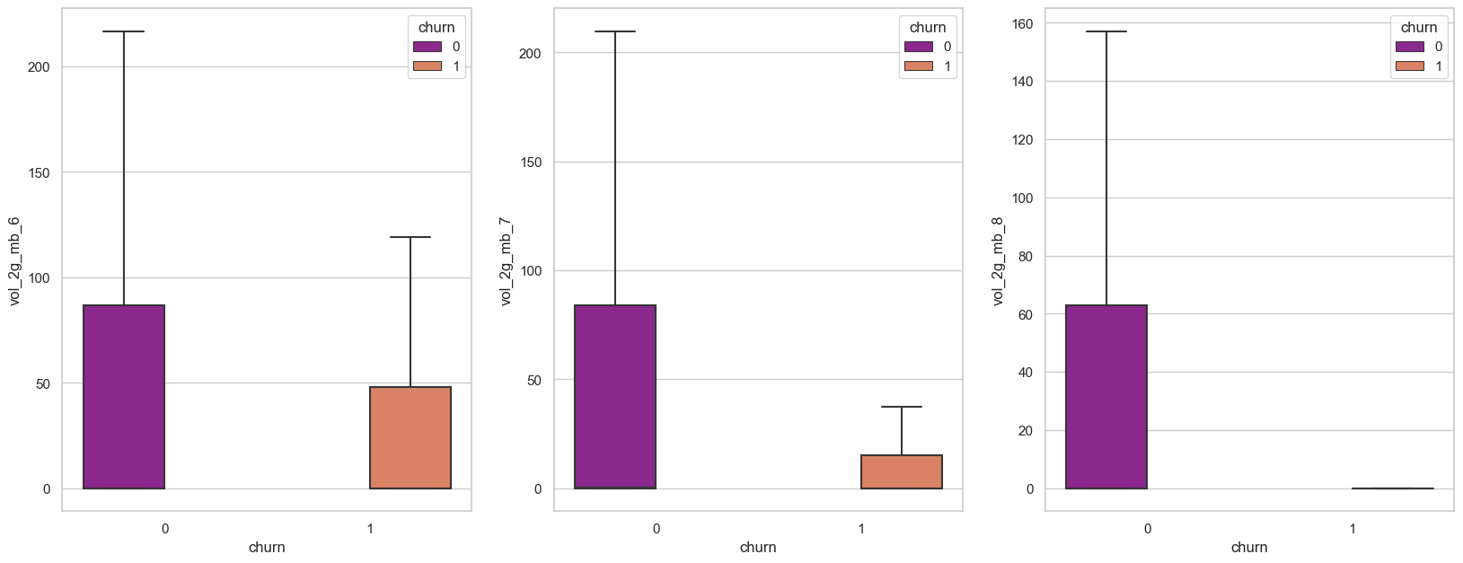
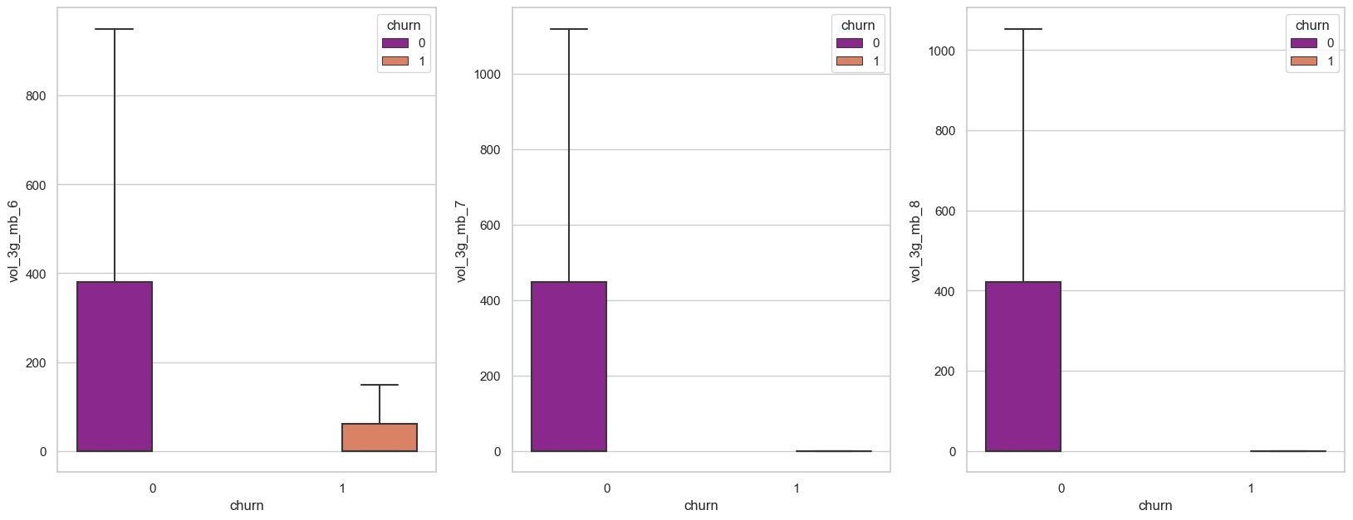

Slide 7
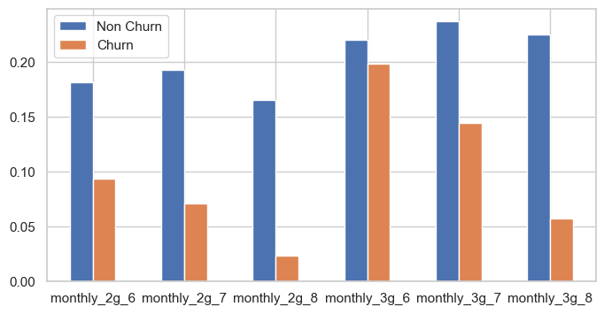
There is a drop in monthly subscription for churned customers in 8th Month.

Slide 8
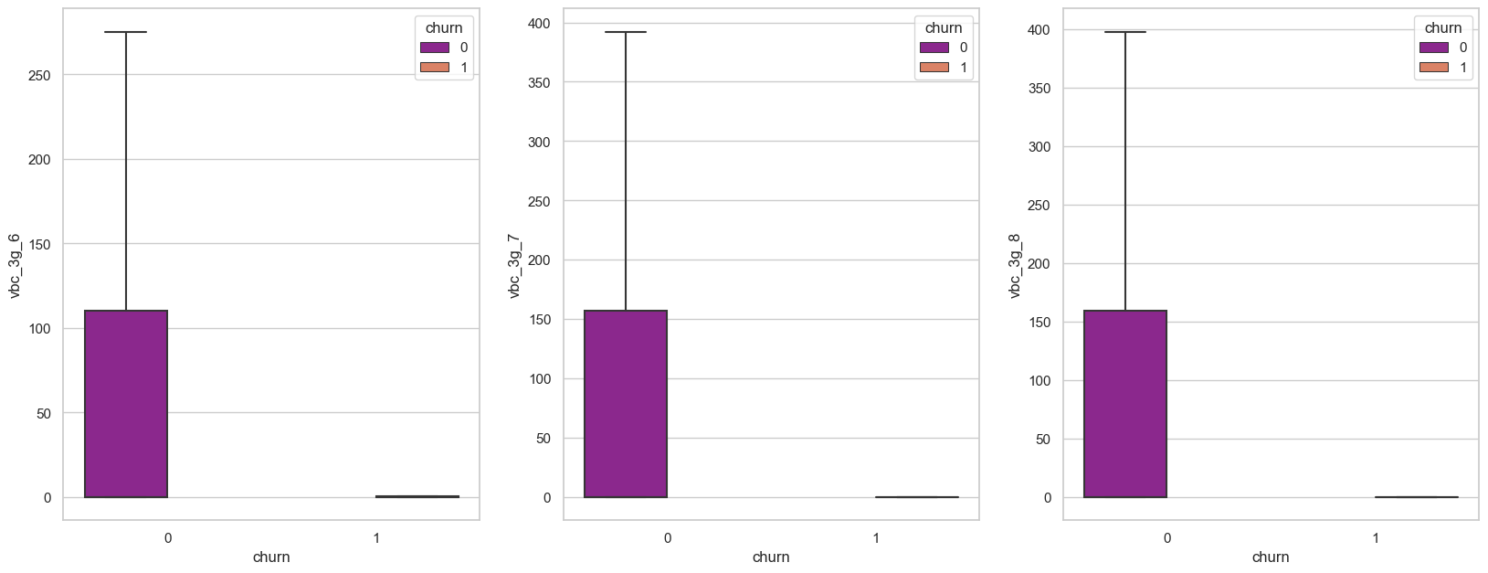
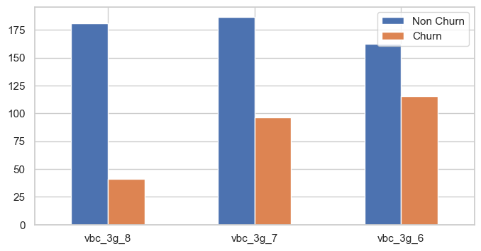

Slide 9
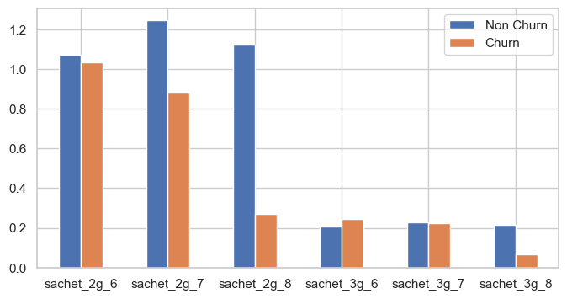
Drop in sachet services in 8th month for churned customers

Slide 10
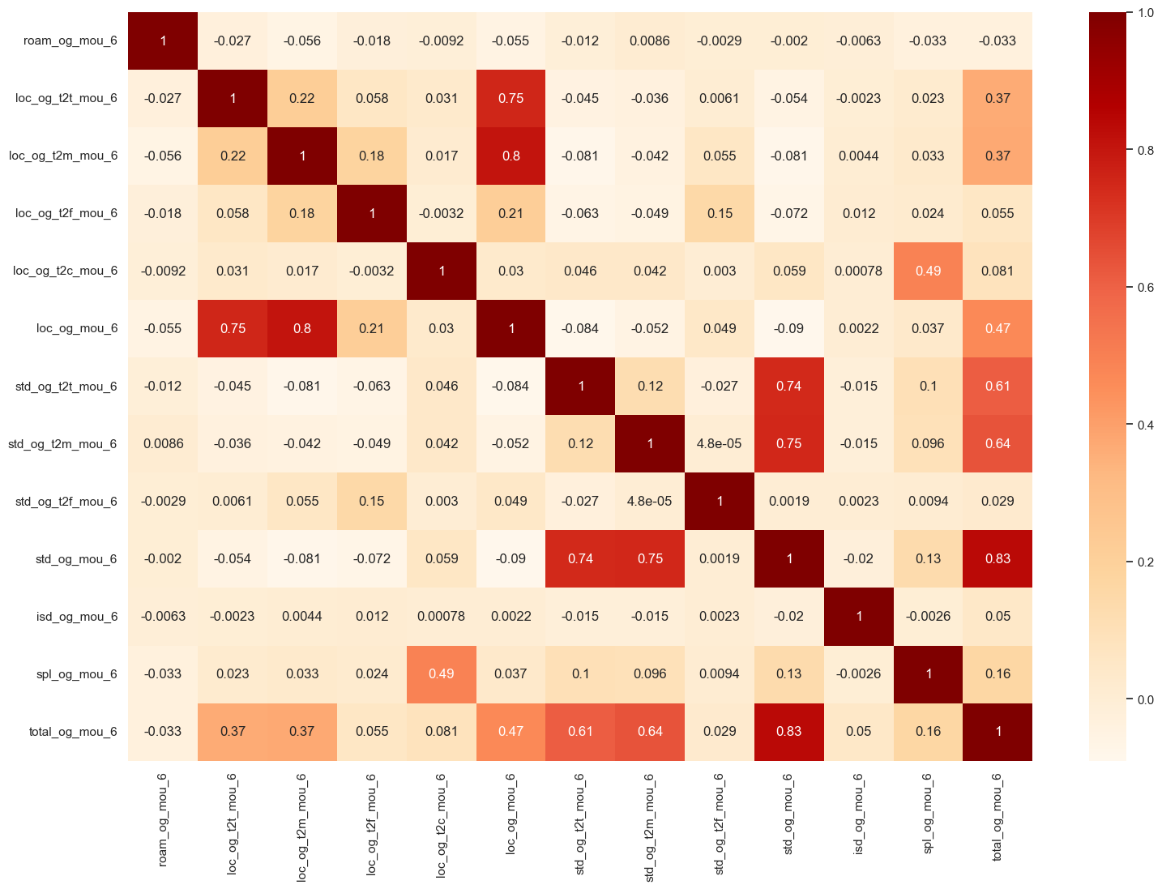

Multivariate
analysis
The total_og_mou_6, std_og_mou_6 and loc_og_mou_6 have strong correlation with other fields and they need to be inspected to avoid any multicollinearity issues.

Slide 11
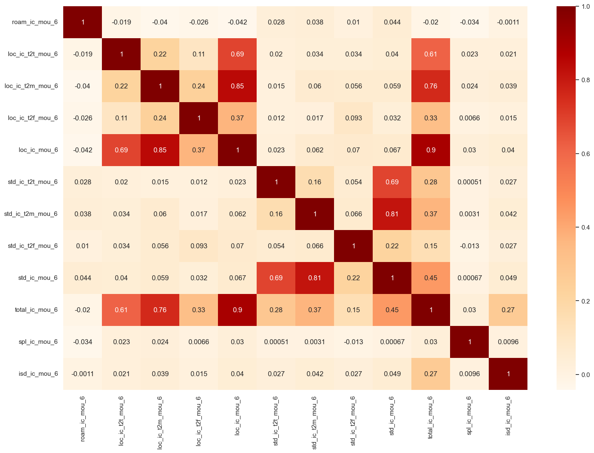
The total_ic_mou_6, std_ic_mou_6 and loc_ic_mou_6 seems to have strong correlation with other fields and they needs to be inspected to avoid multicollinearity issues.

Slide 12
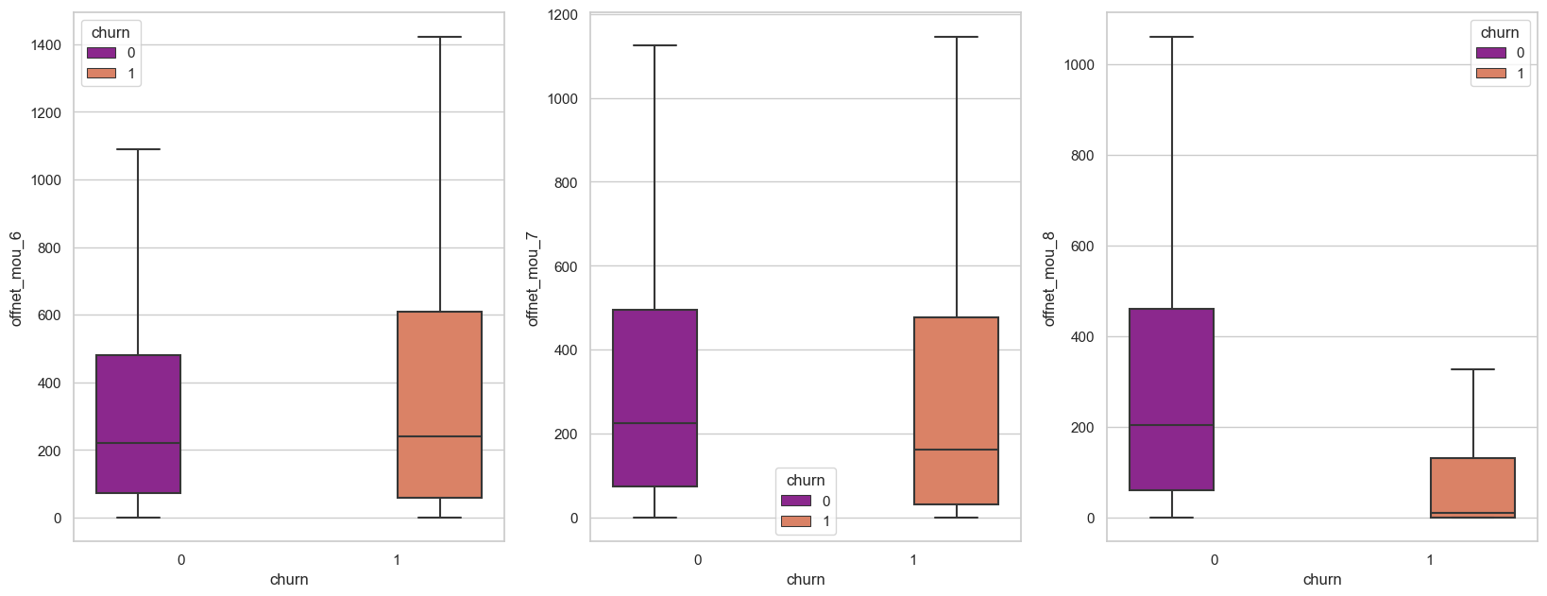
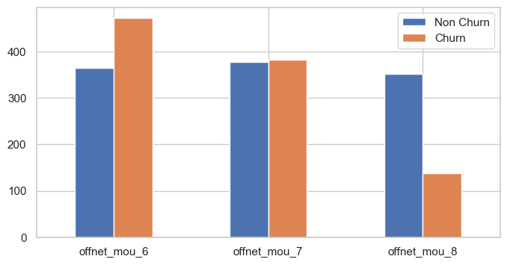
There is a drop for off net mou services in the 8th month

Slide 13
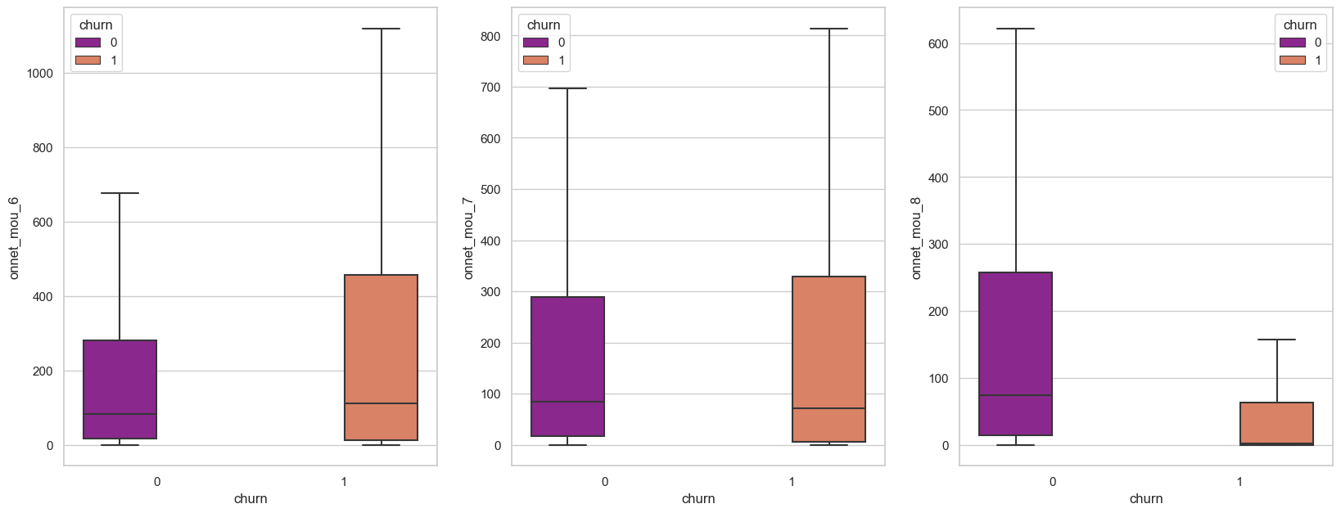
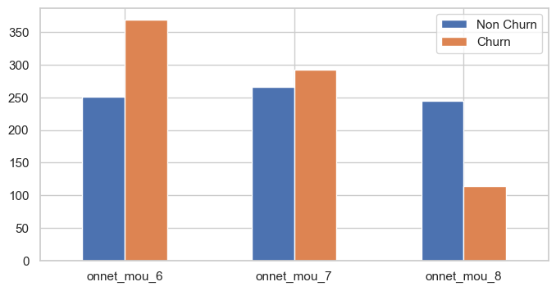

Slide 14
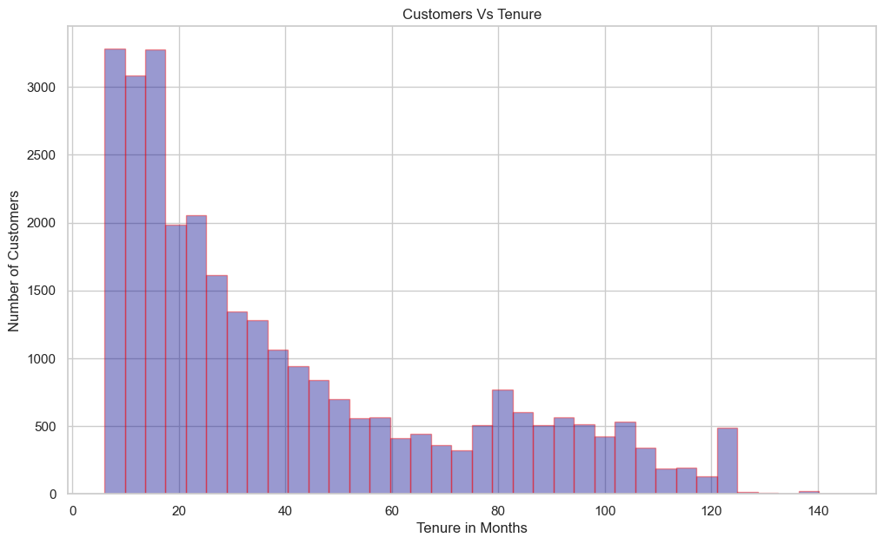
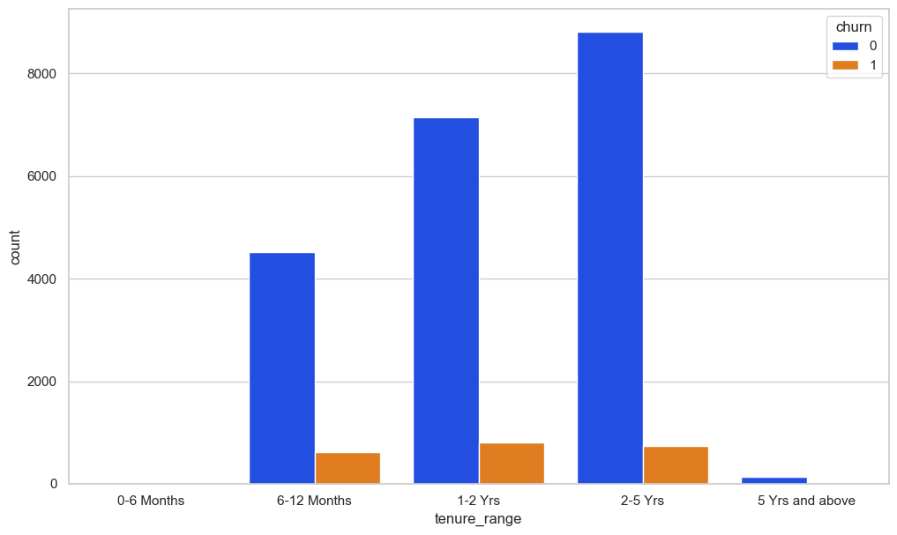

Slide 15
EDA - INFERENCES
huge drop in total recharge number also in the 8th month
drop in maximum recharge for data also in the 8th month
huge drop in 8th month recharge amount for churned customers
drop in monthly subscription for churned customers in 8th Month.
sachet services in 8th month for churned customers
there is a drops for Arpu in 8th month for churned customers
The total_og_mou_6, std_og_mou_6 and loc_og_mou_6 have strong correlation with other fields and they needs to be inspected to avoid any multicollinearity issues.
The total_ic_mou_6, std_ic_mou_6 and loc_ic_mou_6 seems to have strong correlation with other fields and they needs to be inspected to avoid multicollinearity issues.

Slide 16
Handling Imbalanced Dataset:
Churn rate is less than 10% of the overall data available. This indicates that we would need to handle the class imbalance in this classification problem.
We can handle imbalanced classes by balancing the classes by increasing minority or decreasing majority. These are following few techniques.
Random Under-Sampling
Random Over-Sampling
SMOTE - Synthetic Minority Oversampling Technique
we ran three different algorithm (Logistic Regression, Decision tree, Random forest)with above techniques to handle imbalanced classes.
We pick up Logistic Regression with Over-Sampling method as best performing model (based on Highest Recall value ).

Slide 17
Model Building
Train set
Accuracy = 0.84
Sensitivity = 0.86
Specificity = 0.82
Test set
Accuracy = 0.82
Sensitivity = 0.82
Specificity = 0.82
Splitting data into train and test set (70:30 ratio)
Use RFE to choose top 25 feature variables for model building
Repeated model building by removing variable whose p-value is more than 0.05
and VIF value greater than 5
Balancing all metrics, 0.55 is taken as optimal cut off point
With 0.55 as cut off point, below are performance evaluation metrics for train &
test data set.
Final model is built and with probability threshold value of 0.55

Slide 18
Feature Analysis:
Minutes of usage is one of the most important feature in churn prediction in action phase(i.e 8th month). Minutes of usage (Voice) in the action month is a very good indicator for customer churn. As the MOU in 8th month decreases, the chances of the customer churning out increases.
Drop in Last day recharge amount in the action month(8th month) is an important indicator for churn of high value customers.
Churn customers seems to have a relatively High ARPU (Average Revenue Per User) in the good phase, indicating that a sudden downturn in the ARPU from good to action phase is a major indicator of the customer churn.

Slide 19
Conclusions
Less number of high value customer are churing but for last 6 month no new high valued customer is onboarded which is concerning and company should concentrate on that aspect.
Customers with less than 4 years of tenure are more likely to churn and company should concentrate more on that segment by rolling out new schemes to that group.
Average revenue per user seems to be most important feature in determining churn prediction.
Incoming and Outgoing Calls on roaming for 8th month are strong indicators of churn behavior
Local Outgoing calls made to landline , fixed line , mobile and call center provides a strong indicator of churn behavior.
Better 2G/3G area coverage where 2G/3G services are not good, it's strong indicator of churn behavior.

Slide 20
Business Recommendations:
To recently joined customers (Tenure: 0-2 years) can be provided add on incentives for certain period.
Provide incentives on recharge of data or voice to high value customers in the action phase to increase customer retention.
Incentives based on usage can be provided to Customer having high ARPU in good phase to drive up the ARPU in action phase and retain the customer.
Can provide free or discounted local on net and mobile usage voice minutes during the action phase.
To retain customers, we need higher recall. As giving an offer to an user not going to churn will cost less as compared to loosing a customer and bring new customer, we need to have high rate of correctly identifying the true positives, hence recall.

Slide 21

Thank you

